Slide 1

Self Management
Self Regulation

Slide 2

What is Self-Regulation?
The ability to manage your emotions and behavior.
Learning to not be impulsive when faced with upsetting or unexpected situations.
  Examples of impulsive behavior?
Handling frustration without an outburst.
Calming yourself down when you’re upset.

Slide 3


Zones of Regulation – Quick overview
There are 4 zones:
  Blue –
    when you feel sad, tired, sick or bored.
    When your brain is moving slowly or sluggishly.
  Green
    Calm, happy, focused or content
    Being in the green zone shows control
    GREEN is the GOAL

Slide 4


Zones of Regulation – Quick overview
  Yellow –
    Experiencing stress, frustration, anxiety, excitement, silliness, nervousness.
    Starting to lose some control.
  Red –
    Experiencing anger, rage, explosive behavior, panic, terror or elation.
    Not being in control of one’s body.

Slide 5
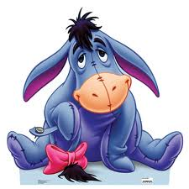
The Blue Zone
  Eeyore in the Blue Zone
  https://youtu.be/f_bD5SysAMk?list=PLex1ABIduQCn4KrQBHp4EKOXkoAnlGrEH
When were you in the Blue Zone?
  How did you feel on the inside?
  How can you tell someone else is in the blue zone??
  Discuss in groups.

Slide 6

The Green Zone
Nemo in the Green Zone
https://youtu.be/eWXOurnVTYg?list=PLex1ABIduQCmp1tReZ8quhBBGqb-8NE2S
When were you in the Green Zone?
  How did you feel on the inside?
  How can you tell someone else is in the green zone?
  Discuss in groups.

Slide 7

Yellow Zone
Shrek in the Yellow Zone
https://youtu.be/4vUBsTJYK28?list=PLex1ABIduQClLtwYJAHS_MAIc2ec_OTTn
What does a yellow light mean? CAUTION
  How do we know when we’re in yellow?
When were you in the Yellow Zone?
  How did you feel on the inside?
  How can you tell someone else is in the yellow zone?
  Discuss in groups.

Slide 8
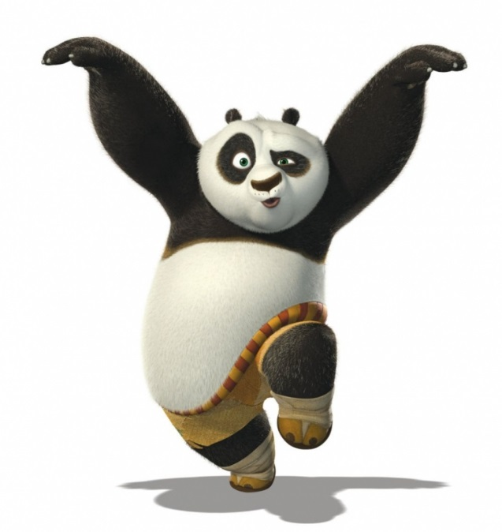
Red Zone
Po (Kung Fu Panda) in the Red Zone
https://youtu.be/GUugDgo9SJ4?list=PLXXlw5bZYnCqtq03LaaeNuxAcHozkUfag
When were you in the Red Zone?
  How did you feel on the inside?
  How can you tell someone else is in the red zone?
  Discuss in groups.

Slide 9
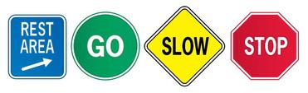
How do you move from Zone to Zone?
Is it possible to move from Zone to Zone?? How?
What are some ideas to help you move Zones?
  Brainstorm

Slide 10
How can I self-regulate?
Move around
Take deep breaths
Count to 10
Talk to a friend
Use positive self-talk
Get a drink
Take a break/rest
Distract yourself
What else???

